Slide 1

Mapping the pokemon tcg leaderboard
Daniel Hing
Notes:
Hi everyone, this is Greg, Josh and my presentation on Electric Vehicle Adoption in Australia

Slide 2



Goals
To build an interactable map upon which visualizes the data Championship Leaderboard presented by pokemon.com for the Pokémon Trading Card Game, (to see which countries are the very best that no one ever was)
Notes:
So starting with what goals I had for this project, which was to build an interactable map upon which visualizes the data Championship Leaderboard presented by pokemon.com for the Pokemon Trading Card Game, (to see which countries are the very best that no one ever was)

Slide 3

INTRODUCTION
Much like the PGA Tour or ATP for golf or tennis, Pokémon provides a leaderboard that provides a continually updating snapshot of championship points earned by Pokémon Trading Card Game Players
Notes:
Much like the PGA Tour or ATP for golf or tennis, Pokemon provides a leaderboard that provides a continually updating snapshot of championship points earned by Pokemon Trading Card Game Players

Slide 4
Data Acquisition
Notes:
So our first section is a quick dive into the method of how we acquired the data required for our study.

Slide 5
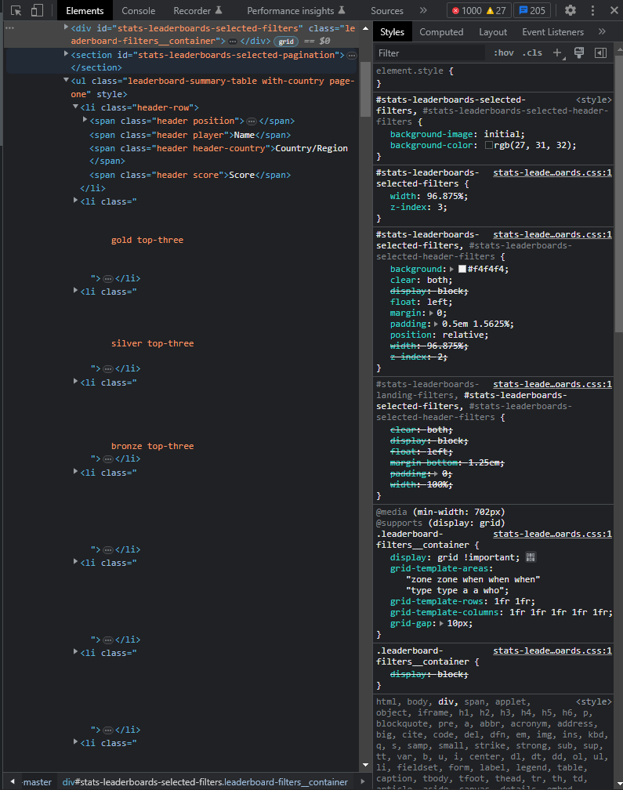
Building a database: Inspecting Data
Used to get name/score/country data
Pokémon provides a public facing leaderboard at https://www.pokemon.com/us/play-pokemon/leaderboards/tcg-masters/
To acquire this data I utilized python to learn about the structure of the html. Once I learnt about the structure of the data I moved the html into added it to my resources. The usable data was a player name, a score and a country name/country code the player comes from.
Notably this did not provide coordinates to each country’s location
Notes:
Pokemon provides a public facing leaderboard at https://www.pokemon.com/us/play-pokemon/leaderboards/tcg-masters/
To acquire this data I utilized python to learn about the structure of the html. Once I learnt about the structure of the data I moved the html into added it to my resources. The usable data was a player name, a score and a country name/country code the player comes from.
Notably this did not provide coordinates to each country’s location

Slide 6
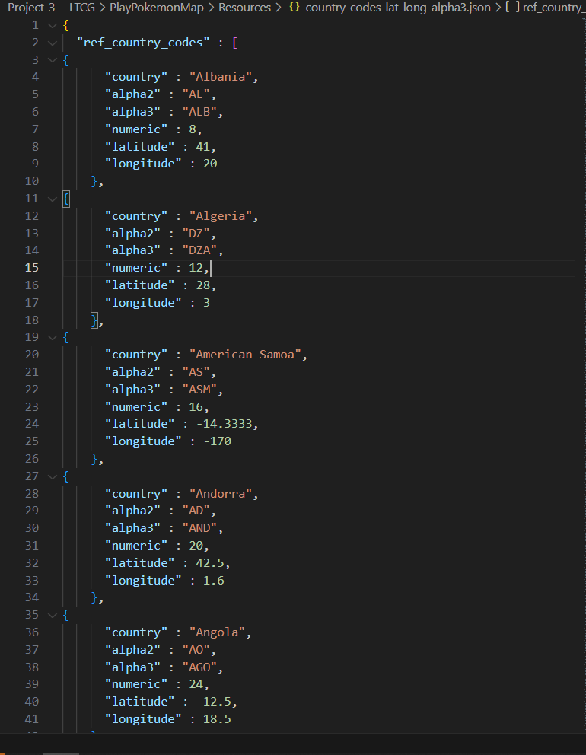
Building a database: Acquiring latitude and longitude
I used tadast’s countries_codes_and_coordinates found at https://gist.github.com/tadast/8827699 which gave a CSV which included Alpha-3 codes, latitude and longitude in its’ data. I converted the document to a json then in python paired the latitude and longitude coordinates with the Pokémon league table data
Notes:
A simple request with postcodes as our rows and one of our 3 key indicators resulted in a CSV with the information almost ready for input into pandas. The data cleaning process involved the removal of header text, totals, and non personal vehicles. Then within python we removed null values from our data.
Shown on the slide is the processed input we use in our project.

Slide 7

Building a database
I took the updated country and coordinate data and then iterated through the player data, storing new values for player count and score and then output them to a json
Notes:
Also useful in our study was the website https://www.matthewproctor.com/
This is a small personal dev blog which contains multiple databases with publicly available information collated into sets.
In a our investigations we found out that Auspost used to provide postcode data for free however it’s now a charged service. That said most of this data is still available in the public domain uncollated. Matthew Proctor collated as much of this data as possible to provide a public database
We used this database on postcodes to make our own database more sophisticated as we can match this data to our existing ABS acquired data

Slide 8
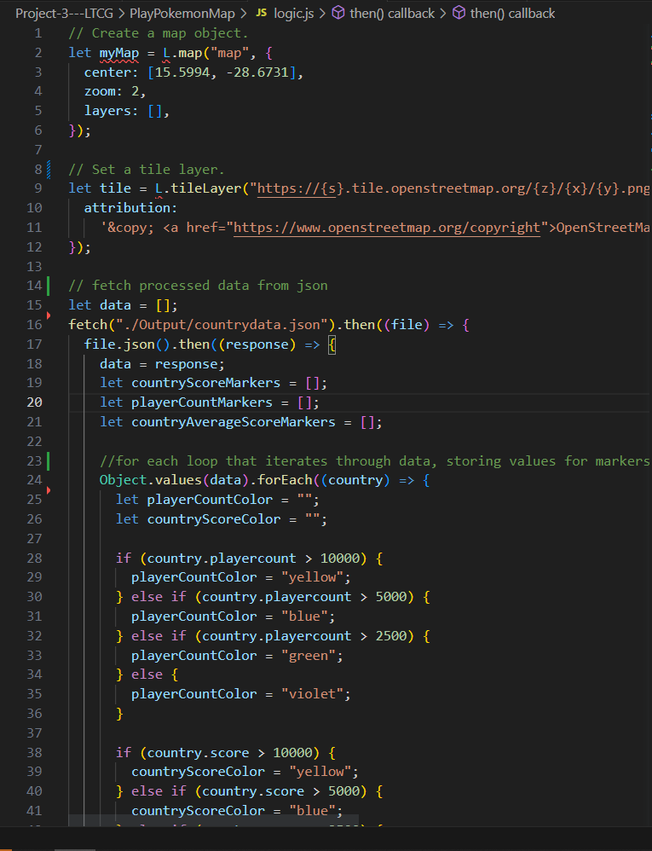
Building a Map
Using JavaScript and the leaflet library I iterated through the newly built database to build different marker groups representing a country’s total championship points, player count and the average performance of a player.
I then created a map that utilised these different stored values to create map visualisations that were independently viewable
Notes:
Also useful in our study was the website https://www.matthewproctor.com/
This is a small personal dev blog which contains multiple databases with publicly available information collated into sets.
In a our investigations we found out that Auspost used to provide postcode data for free however it’s now a charged service. That said most of this data is still available in the public domain uncollated. Matthew Proctor collated as much of this data as possible to provide a public database
We used this database on postcodes to make our own database more sophisticated as we can match this data to our existing ABS acquired data

Slide 9
Output
Notes:
The first part of our study revolves around our hypothesis that “If a postcode has higher overall education levels then then number of electric vehicles will increase”

Slide 10
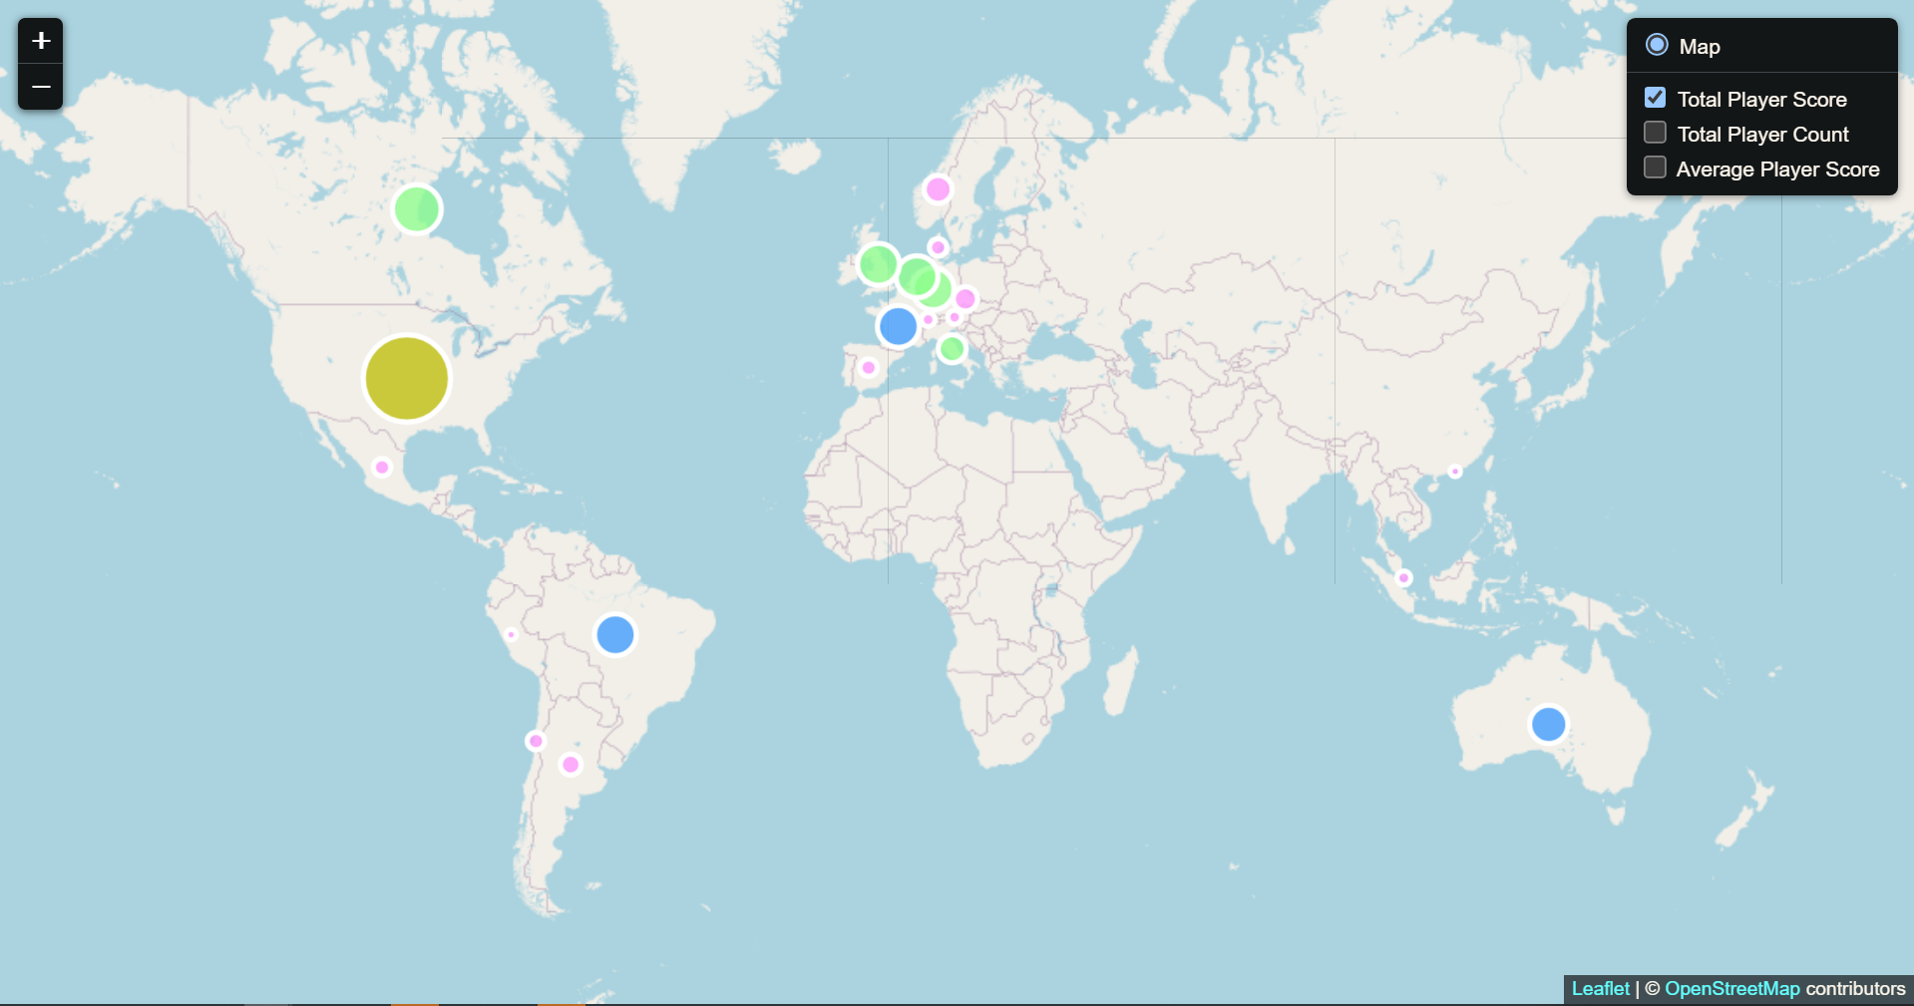
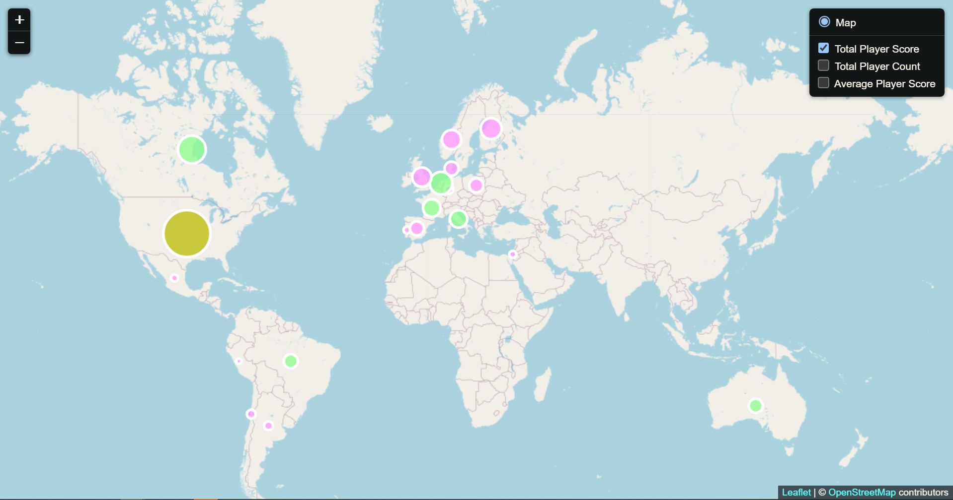
Output for Total Player Score
Output for Player Score in 2020
Output for Player Score in 2023
Notes:
And here it is!

Slide 11
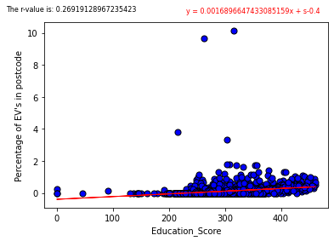
Output analysis
Line of Best Fit
Conclusions
Our line of best fit shows a positive correlation between higher levels of education and electric vehicle adaptation
R value of 0.259 is relatively low
A lot of the data consists of many low population post codes
Pulled postcode info via matthewproctor.com to apply filters for rural and metro postcodes
Applied a filter for over 5000 vehicles
For postcodes below 5000 vehicles most postcodes have 0 electric vehicles, many postcodes have single digit vehicle counts. This is likely due to infrastructural issues
For postcodes above 10000 vehicles correlation becomes strong (r value=0.68) but we lose too many relevant data points
Notes:
Now you may notice that the line of best fit does show a positive gradient across the dataset. However our R value is fairly low. When our data gave us this output we investigated potential causes. As our dataset included all postcodes in Australia, we realised it featured thousands of uninhabited or very sparsely inhabited postcodes. Due to the nature of EVs requiring locally built infrastructure (such as charging stations, distributors, maintenance facilities) we realised that in some areas it’s simply not feasible to utilise EVs in low population areas. So we applied 2 filters to our database. One of which utilised the data from matthewproctor.com to apply a filter for Metro or Rural postcodes and secondly to remove all datapoints with populations below 5000 vehicles.

Slide 12
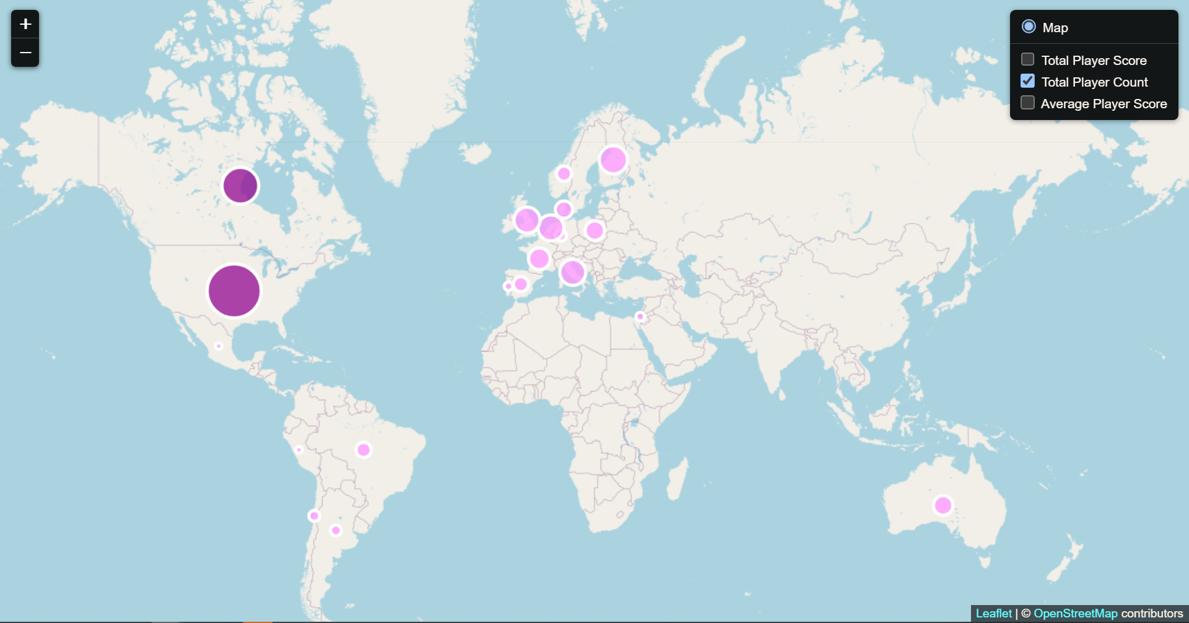
Output for Total Player Count
Notes:
So this is the result of applying our filters to the dataset.
To get an idea of how many data points are removed when filters are applied we had
Combined = 2633 data points
Rural > 5000 = 604 data points
Metro >5000 = 344 data points
As you can see, in comparison to the “All Postcodes” graph, our newly created plots feature a much stronger correlation, with an R-value of 0.629 for metro areas and an R-value of 0.672 for rural. This showed that there was in fact a considerable correlation between education and adoption of electric vehicles. We were also somewhat surprised to find that within populated postcodes rural areas actually exhibited a stronger correlation to electric vehicle adoption than in metro areas. Although it is noted this doesn’t mean a higher usage rate of electric vehicles in rural areas.

Slide 13

Case study
Outlier dive
The 4 highest EV% outliers in combined dataset are removed by the filters
Postcode 3026-10.12% Laverton North, VIC
4600 Vehicles
Location of former Toyota manufacturing plant, now a hydrogen refuelling facility
Toyota Mirai sedans were distributed locally as part of the company’s trial program, with easy access to EV refuelling at Toyota’s nearby station
Postcode 6462-9.68% Minnivale WA
31 Vehicles
3 Evs
Postcode 2308-3.82% Newcastle NSW
157 Vehicles
Postcode 2609-3.35% Fyshwick ACT
4900
Significant data point that gets dropped
Notes:
When we filtered for data despite removing a lot of empty postcodes we also found that it removed the 4 highest percentage EV using postcodes too. We did a deeper investigation into each of these outliers to learn more about the ones that got filtered out. We found a unique case in the postcode with the highest adoption rates in Australia. North Laverton, Victoria is the location of what used to be Toyota’s Australian manufacturing plant. It seems that the local postcode was part of a pilot program that involved distribution of Toyota’s Mirai sedans, and investment into local EV supporting infrastructure. Currently the defunct manufacturing plant is now a refuelling facility. We cannot directly link our EV numbers to individuals or their purchase history but we found it reasonable to conclude that this anomaly was due to extenuating circumstances.
The suburb of Minnivale, WA has a high percentage but also a very low population count so we felt that a 9.68% adoption rate which in reality was 2-3 households was statistically insignificant. We felt similarly about Newcastle in NSW with a population of 157 vehicles although this data is closer to the national average.
We also noted that the 4th highest data point lost was Fyshwick, which unfortunately was cut as we felt it represented a strong datapoint for the purposes of the study, however a cut off was necessary and exceptions shouldn’t be made to maintain the integrity of the dataset.

Slide 14
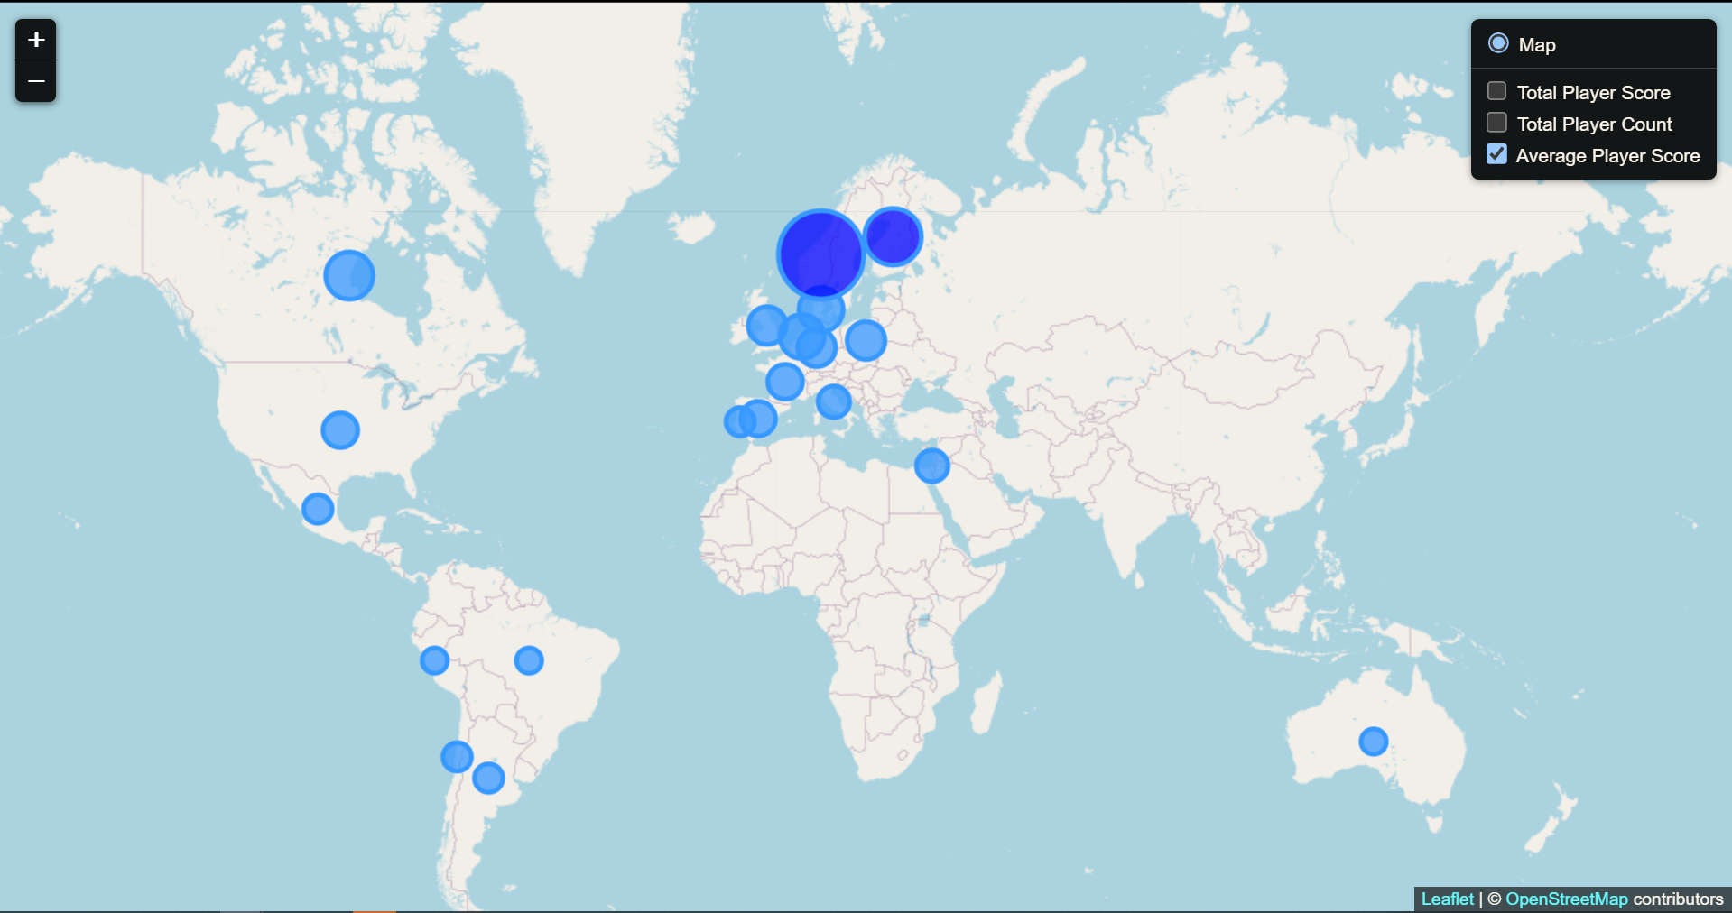
Output for Total Player Count
Notes:
So this is the result of applying our filters to the dataset.
To get an idea of how many data points are removed when filters are applied we had
Combined = 2633 data points
Rural > 5000 = 604 data points
Metro >5000 = 344 data points
As you can see, in comparison to the “All Postcodes” graph, our newly created plots feature a much stronger correlation, with an R-value of 0.629 for metro areas and an R-value of 0.672 for rural. This showed that there was in fact a considerable correlation between education and adoption of electric vehicles. We were also somewhat surprised to find that within populated postcodes rural areas actually exhibited a stronger correlation to electric vehicle adoption than in metro areas. Although it is noted this doesn’t mean a higher usage rate of electric vehicles in rural areas.

Slide 15
Income Analysis
Notes:
The second part of our study revolves around our hypothesis that “If a postcode has higher overall income levels then then number of electric vehicles will increase”

Slide 16
Income Pt1
Problem
Needed to create an x axis to plot representing income levels
Solution
Median while more useful than in education, still has binned data, largely resulting in shared medians
Devise a score/rating for each postcode
Methodology
Processed ABS dataframe to show percentages of residents with each level of income under the provided levels
Notes:
Similarly to education, income comes from ABS in the form of bins with a count of residents.
Using medians a median therefore results with a large number of suburbs particularly those with fewer residents being skewed, particularly when a large number of residents answer to zero or negative incomes, which can be difficult to handle.
A similar method of using weighted values for each income bracket was used to produce an income score for each postcode.
ABS data was therefore processed to produce a percentage of how many residents fit into each income bracket, and these values were multiplied by the weighted values to output an income score.

Slide 17
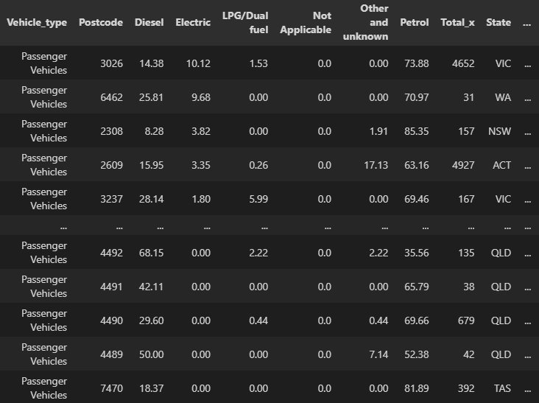
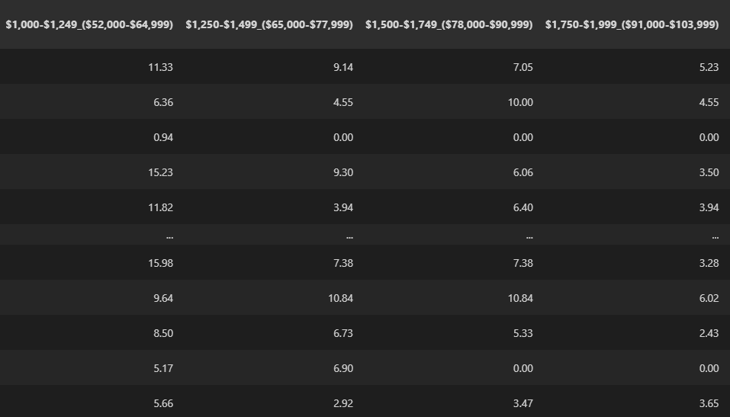
Income Pt2
Methodology
Assigned a multiplier to each level of income, increasing with each level of income
Create an income score for each postcode by summing the multiplied outputs
Plot income score vs electric car prevalence
Notes:
The data is in the form of weekly earnings, with the value in brackets representing annual take home income before tax.
Once an income score was produced, the table was merged with vehicle fuel type data so that they could be analysed together.

Slide 18
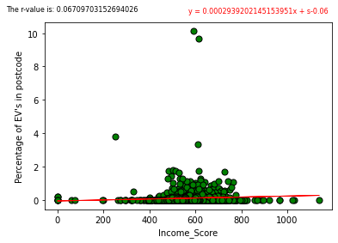
Output for Income Score
Notes:
Once plotted, we can see that once again we are dealing with some issues relating to outliers on the y axis, as well as a large number of values sitting at zero

Slide 19
Output analysis
Line of Best Fit
Conclusions
Our line of best fit shows a weak correlation between income and electric vehicle adaptation
R value of 0.069 is very low
A lot of the data consists of many low population post codes
Pulled postcode info via matthewproctor.com to apply filters for rural and metro postcodes
Applied a filter for over 5000 vehicles
For postcodes below 5000 vehicles most of these postcodes feature single digit car counts and 0 EVs
For postcodes above 10000 vehicles correlation becomes strong (r value=0.68) but we lose too many relevant data points
Notes:
As before, without drilling down into the data and cleaning it up, there is little to no correlation.
In order to fix this, we settled on 5000 vehicles or greater, as this tends to remove much of the “noise” from postcodes with very few vehicles, or residents.

Slide 20
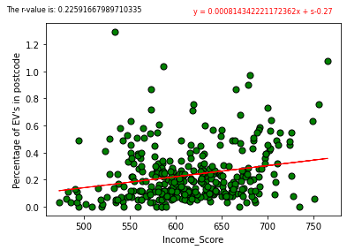
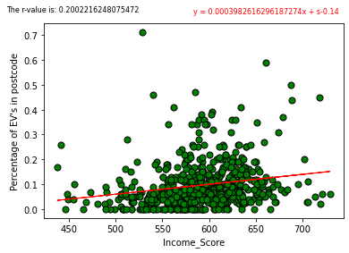
Output for Education Score
All Postcodes
Metro Postcodes, Population > 5000
Rural Postcodes, Population > 5000
Notes:
Interestingly when compared to education, despite the relatively high cost of electric vehicles, income has a fairly low correlation with EV’s.
And although quite low, there doesn’t appear to be much difference when comparing metro or regional areas inclination to purchasing electric vehicles. Although when looking at regional, there is a much larger proportion of postcodes with no EV’s whatsoever.
Potentially suggesting that available infrastructure may be playing a key role.

Slide 21
Relevance Discussion of study
Conclusions
Income tends to be a poor indicator of EV’s suggesting that it may take more than falling prices to encourage residents to make the switch to EV’s.
Education is quite well correlated, leading to the conclusion that it may be peoples understanding of the impact of fossil fuel emissions on the environment that lead to purchasing EV’s.
Availability of infrastructure and dealerships also play an important role.
If monetizing the findings of our study it would be best to focus EV infrastructure development (including dealerships, maintenance etc) to areas of higher average education
Notes:
The key findings from this analysis may suggest that it takes more than falling EV prices to encourage Australians to make a change to EV’s.
Education however is quite well correlated, and may suggest that people who have a better understanding of the impact of fossil fuels on the environment play more of a role in people making the change to EV’s.
It is also worth noting that as seen in the outliers such as Laverton North, having key infrastructure, manufacturing facilities and availability also play a major role.
This study only analyses income and education, however it is important to note that this is a complex issue with many variables, and as such, in order to fully understand the issue, we would need to analyse many other factors to draw a more definitive conclusion.

Slide 22
Bibliography
Australia, MP, Melbourne n.d., Matthew Proctor, Matthew Proctor’s Blog, viewed 30 January 2023, <https://www.matthewproctor.com/>.
Australian Bureau of Statistics <https://tablebuilder.abs.gov.au/>

Slide 23
THANK YOU
Notes:
Thank you for (mandatorily) attending our presentation!

